Slide 1
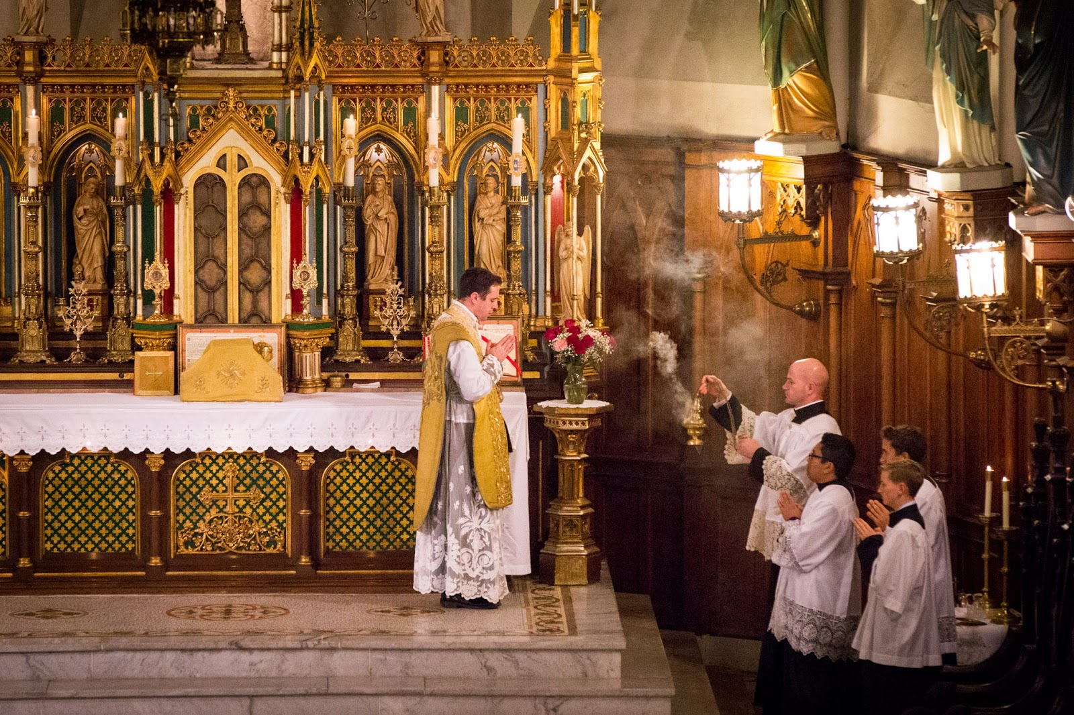

Slide 2
Learning to Pray the Traditional Mass by Learning Latin in an Untraditional Way
No memorization but much repetition and good guessing

Slide 3
Angelico Press

Slide 4
Latin: a Sacred Language
It is good for our souls!

Slide 5
“Following” at the Latin Mass
Very few attendees are able to follow the whole Mass in Latin – even those who know Latin well.
In fact, the priest says many of the prayers “silently” so you can’t follow by hearing.
There are times in the Mass when the choir is singing part of the Mass, while the priest goes on to pray the next part.

Slide 6
At Mass
When beginning to attend the TLM, read the missal prior to Mass and enjoy how reverent the prayers are (google: “Traditional Latin Mass” online resources; e.g., http://www.extraordinaryform.org/handmissals.html)
At Mass, follow as you will, but stop and “sit with” whatever prayer “wants” to settle into your being
Observe what the priest is doing. Note the reverence.
The important thing is to get into a prayerful state of receptivity
Be patient. Eventually you will experience what a transcendent way of worshiping the Traditional Mass is.

Slide 7
Learning Latin for the Mass,the cognate and derivative way
http://inrebus.com/latinderivatives.php
https://en.wikipedia.org/wiki/List_of_Latin_words_with_English_derivatives
https://en.wikipedia.org/wiki/List_of_Latin_words_with_English_derivatives

Slide 8
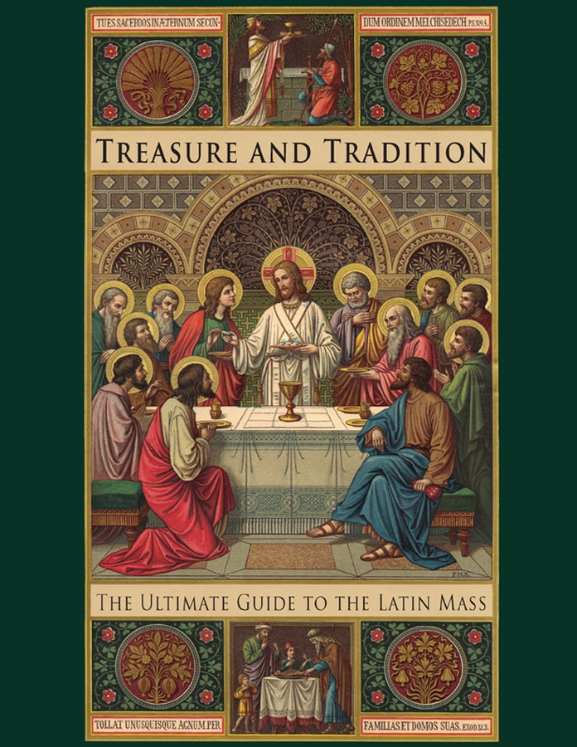
St Augustine
Academy Press

Slide 9
Cognate(Cognate – co–natal)
English words that come from Latin and mean the same thing as in Latin, though they may be different in form
Gloria – glory
Laud – laudare
Adore – adorare

Slide 10
Derivatives (“down-river”)
English words connected to Latin words but not exact in meaning
Mundane – mundus (world): something that is boring is of this world
Dexterous – dexter (right): the right hand can do more than the left [for most people]
Sinister – sinister (left): The left hand is the sneaky hand
Capital – caput (head): The capital city of a state is the “head” city

Slide 11
Latin (dictionary form/ form in prayer) | English and mnemonic aids
Confitere/ confiteor | Confess (or make a statement of faith)
Deus/ deo | Deity
Omnipotens/ omnipotenti | Omni-potent
Beatus/ beatae, beato | Beatify
Semper | Semper fi (fidelity)
Sanctus/ sanctis | Sanctify
Omnis/ omnibus | Omnibus [bill] (omni-potent)

Slide 12
Grammar: How words fit into the meaning of a sentence

Slide 13
Native language learning
I go, you go, he/she/it goes; we go, they go
I have; you have; she has; we have; they have
I gave my ball to him and he gave it back to me.

Slide 14
Uninflected languages: word order
John hit the ball.
The ball hit John.
John ate the alligator.
The alligator ate John.

Slide 15
Inflected language: the “form” or ending of the word
I hit the ball.
The ball, I hit.
The ball hit me.
Me, the ball hit.
They ate the alligator.
The alligator, they ate.
The alligator ate them.
Them, the alligator ate.

Slide 16
Cases: indicate the role of a word in the sentence
Case
Nominative (subject) | I | We | I/ we win
Genitive (possessive) | mine | ours | The book is mine/ ours
Dative (indirect object – give to) | to me | to us | John gave the book to me/ us
Accusative (direct object or object of prepositions) | me | us | John loves me/ us
Ablative (prepositional) | me | us | John took it from me/us
Vocative | “you” | “you” | Hey you, help me!

Slide 17
Variable verb forms
I am | sum | We are | sumus
You are | es | You are | estis
He, she, it is | est | They are | sunt

Slide 18
How this program works: Video 1: Vocabulary and grammar
1. First we will look at the vocabulary in the prayer along with the English cognates or derivatives or some mnemonic aid
We will listen to the prayer chanted or prayed on line
Every segment will include a brief explanation of some of the peculiarities of Latin grammar

Slide 19
Video 2: Interlinear Presentation of Prayer
2. We will review the prayer itself, word by word, in an interlinear form (it may be useful to print this out so you can make notations and take it to Mass with you.
a. Line 1: The Latin
b. Line 2: English translation
c. Line 3: English cognate or derivative

Slide 20
Color code for interlinear translation
Red bold in Latin line | Verb
Blue bold in Latin line | Noun, subject of the sentence
Green bold in Latin line | Object of the verb
Purple bold in Latin line | Relative pronoun
Blue highlighting | Masculine cluster of words
Pink highlighting | Feminine cluster of words
Green highlighting | Neuter cluster of words
Yellow highlighting | Clustered words of different genders
Purple highlighting | Connecting word between clauses

Slide 21
You should pray the prayer everyday for as long as it takes for you to become so familiar with it, you don’t need to look at the English.
And listen to it being prayed or sung online

